Slide 1


Hello every one !!!
love

Slide 2

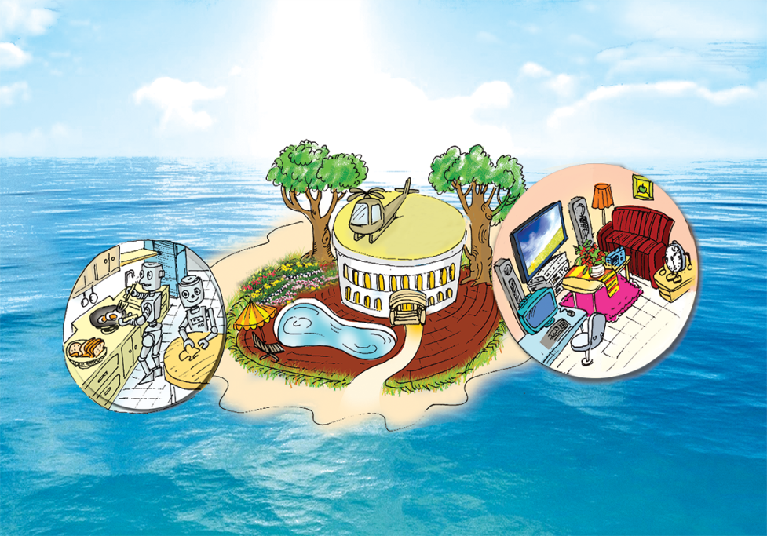
* WARM –UP
Look at the picture and discuss it with a partner.
+ What type of house do you think it is?
+ Where do you think the house is?
+ What can you see around the house?
+ What can you see in the house?
- It's a villa.
- On the ocean
- Trees, a garden, a swimming pool…
- robots , a TV, a computer, …..

Slide 3




LESSON 5
* Reading
* Speaking
OBJECTIVES:
By the end of the lesson, students will be able to:
read for specific information about houses and appliances in the future;
- talk about different houses in the future.

Slide 4
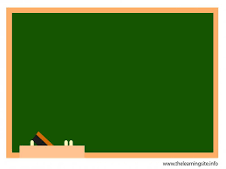
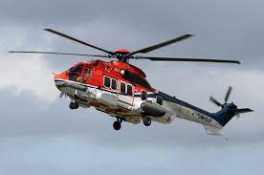
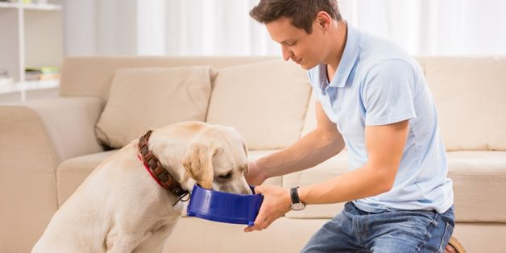
UNIT 10: HOUSES IN THE FUTURE
Lesson 5: Skills 1
* Vocabulary
- surround (v):
- helicopter (n):
- feed (v):
- contact (v):
- super (adj) :
bao quanh
trực thăng
cho ăn
liên lạc
siêu đẳng

Slide 5
UNIT 10: HOUSES IN THE FUTURE
Lesson 5: Skills 1
* Vocabulary
- surround (v):
- helicopter (n):
- feed (v):
- contact (v):
- super (adj) :
bao quanh
trực thăng
cho ăn
liên lạc
siêu đẳng

Slide 6

Read the text and match the beginnings in A with the endings in B.
My future house will be on an island. It will be surrounded by tall trees and the blue sea. There will be a swimming pool in front of the house. There will be a helicopter on the roof. I can ﬂy to school in it.
There will be some robots in the house. They will help me to clean the ﬂoors, cook meals, wash clothes and water the ﬂowers. They will also help me to feed the dogs and cats.
There will be a super smart TV. It will help me to send and receive emails, and contact my friends on other planets. It will also help me to buy food from the supermarket.

Slide 7
* Match the beginnings in A with the endings in B.
A
B
a. clean the floors.
c. wash clothes.
e. cook meals.
g. feed the dogs and cats
h. water the flowers.
b. contact my friends.
d. buy food from the supermarket.
f. send and receive emails.
B
a. clean the floors.
b. contact my friends.
1.
The house will have robots to
c. wash clothes.
d. buy food from the supermarket.
e. cook meals.
2.
The house will have a super smart TV to
f. send and receive emails.
g. feed the dogs and cats.
h. water the flowers.

Slide 8

Read the text again and circle the option (A, B, or C) to complete the sentences.
1.
The house will be _______.
A.
in the mountains
B.
on an island
C.
on the Moon
2.
There will be a _______ in front of the house.
A.
garden
B.
pond
C.
swimming pool
3.
The house will have _______ robots.
A.
B.
some
many
C.
a lot of
4.
The _______ will help me to feed the dogs and cats.
A.
helicopter
B.
robot
C.
super smart tv

Slide 9

LUCKY NUMBER!
1
2
3
4
5
6

Slide 10
Read the text again and circle the option (A, B, or C) to complete the sentences.
My future house will be on an island. It will be surrounded by tall trees and the blue sea. There will be a swimming pool in front of the house. There will be a helicopter on the roof. I can ﬂy to school in it.
1.
The house will be _______.
A.
in the mountains
B.
on an island
C.
on the Moon

Slide 11
Read the text again and circle the option (A, B, or C) to complete the sentences.
My future house will be on an island. It will be surrounded by tall trees and the blue sea. There will be a swimming pool in front of the house. There will be a helicopter on the roof. I can ﬂy to school in it.
2.
There will be a _______ in front of the house.
A.
garden
B.
pond
C.
swimming pool

Slide 12
Read the text again and circle the option (A, B, or C) to complete the sentences.
There will be some robots in the house. They will help me to clean the ﬂoors, cook meals, wash clothes and water the ﬂowers. They will also help me to feed the dogs and cats.
3.
The house will have _______ robots.
A.
B.
some
many
C.
a lot of

Slide 13
Read the text again and circle the option (A, B, or C) to complete the sentences.
There will be some robots in the house. They will help me to clean the ﬂoors, cook meals, wash clothes and water the ﬂowers. They will also help me to feed the dogs and cats.
4.
The _______ will help me to feed the dogs and cats.
A.
helicopter
B.
robot
C.
super smart tv

Slide 14

LUCKY NUMBER!

Slide 15
LUCKY NUMBER!

Slide 16
Read the text again and circle the option (A, B, or C) to complete the sentences.
1.
The house will be _______.
A.
in the mountains
B.
on an island
C.
on the Moon
2.
There will be a _______ in front of the house.
A.
garden
B.
pond
C.
swimming pool
3.
The house will have _______ robots.
A.
B.
some
many
C.
a lot of
4.
The _______ will help me to feed the dogs and cats.
A.
helicopter
B.
robot
C.
super smart tv

Slide 17

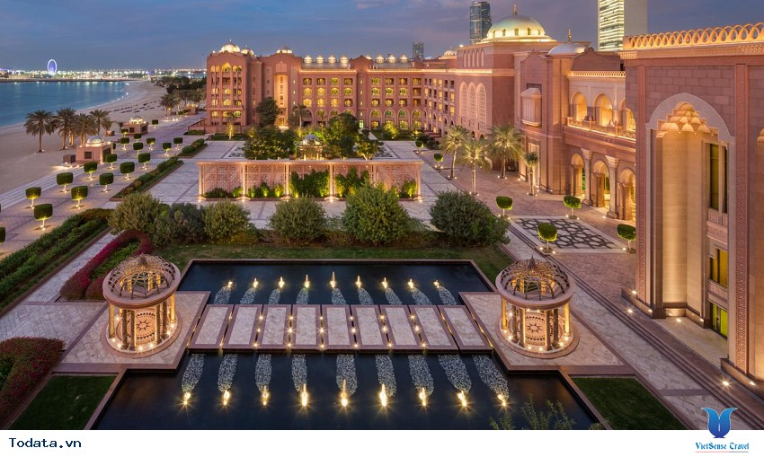
* Speaking
Work in pairs. Ask your partner about his / her future house. Use the suggested questions.
Example:
A: What type of future house do you think it will be?
B: It’ll be a palace.

Slide 18
Work in pairs. Ask your partner about his / her future house. Use the suggested questions.
* Suggested answers:
A: What type of future house do you think it will be?
B: It’ll be a villa.
A: Where will it be?
B: It’ll be on the hill.
A: What will it look like?
B: It’ll be very big, modern, beautiful and convenient.
A: How many rooms will it have?
B: It will have ten rooms: four bedrooms, two bathrooms, a kitchen, a dining room, a living room, a study.
A: What appliances will it have and what will they help you to do?
B: It will have smart appliances: a robot, a dishwasher, a washing machine, a fridge, a smart cooker and they will help us to do all the housework.

Slide 19

Choose one sportsperson in 4. Talk about him / her. Use the following cues.
Example 1 :
My future house will be a palace. It’ll be on the Moon. There’ll be a super smart TV in the house. It’ll help me to talk to my friends on other planets.
Example 2 :
My future house will be a very big and beautiful villa. It’ll be on the hill. There will be ten rooms with smart appliances in each room. They will help us do all the housework easily and quickly.

Slide 20

homework
- Learn all the new words by heart.
- Do exercises in the workbook.
- Prepare: Skills 2

Slide 21




